Slide 1
Project Showcase: Building a Weather Application

Slide 2

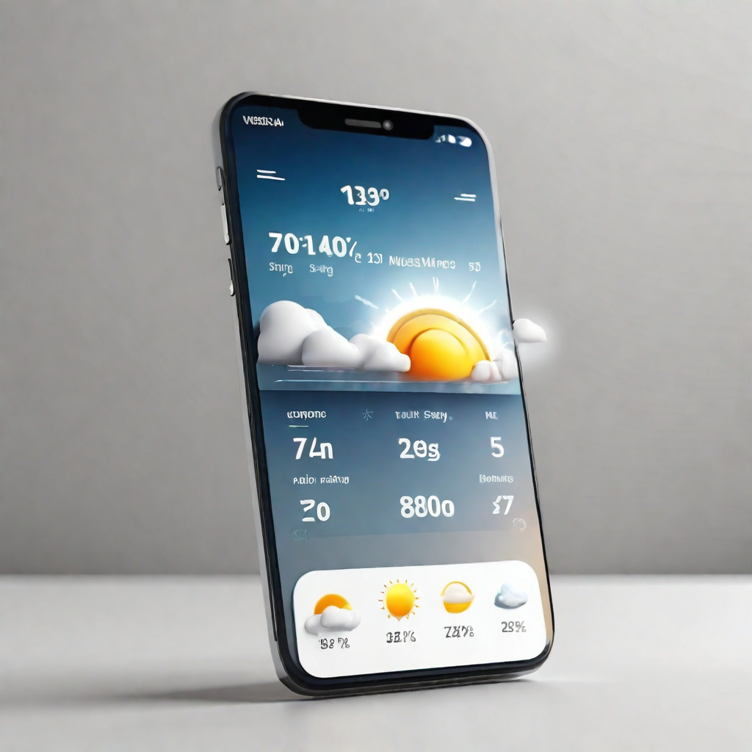

INTRODUCTION
The weather application project is focused on creating a user-friendly application that provides real-time weather data to users. By utilizing various technologies such as programming languages, GUI libraries like Tkinter, and an external weather API, we aim to deliver an efficient and accurate weather application.
Key Technologies
DESCRIPTION
TECHNOLOGY
Utilizing programming languages like Python and JavaScript to develop the weather application.
Programming Languages
Using GUI libraries like Tkinter to create a user-friendly interface for the weather application.
GUI Libraries (e.g., Tkinter)
Integrating an external weather API to fetch real-time weather data and provide accurate information to users.
External Weather API

Slide 3
INTRODUCTION
The weather application project is focused on creating a user-friendly application that provides real-time weather data to users. By utilizing various technologies such as programming languages, GUI libraries like Tkinter, and an external weather API, we aim to deliver an efficient and accurate weather application.
Key Technologies
DESCRIPTION
TECHNOLOGY
Utilizing programming languages like Python and JavaScript to develop the weather application.
Programming Languages
Using GUI libraries like Tkinter to create a user-friendly interface for the weather application.
GUI Libraries (e.g., Tkinter)
Integrating an external weather API to fetch real-time weather data and provide accurate information to users.
External Weather API

Slide 4

How it Works
The weather application utilizes an API key to securely access external weather data. By sending a request to an external weather API, the app retrieves up-to-date information and processes the received JSON data. The key functionalities of the app include the ability to search for a city and display the corresponding weather information.
Functionality
Description
API Integration
The app integrates with an external weather API by using an API key for secure access to weather data.
Data Retrieval
The app sends a request to the weather API to retrieve up-to-date weather information for a specified city.
Data Processing
The received JSON data from the weather API is processed to extract relevant weather information.
City Search
Users can search for a specific city to view its current weather conditions.
Weather Display
The app displays the weather information, including temperature, humidity, wind speed, and weather conditions.

Slide 5
How it Works
The weather application utilizes an API key to securely access external weather data. By sending a request to an external weather API, the app retrieves up-to-date information and processes the received JSON data. The key functionalities of the app include the ability to search for a city and display the corresponding weather information.
Functionality
Description
API Integration
The app integrates with an external weather API by using an API key for secure access to weather data.
Data Retrieval
The app sends a request to the weather API to retrieve up-to-date weather information for a specified city.
Data Processing
The received JSON data from the weather API is processed to extract relevant weather information.
City Search
Users can search for a specific city to view its current weather conditions.
Weather Display
The app displays the weather information, including temperature, humidity, wind speed, and weather conditions.

Slide 6
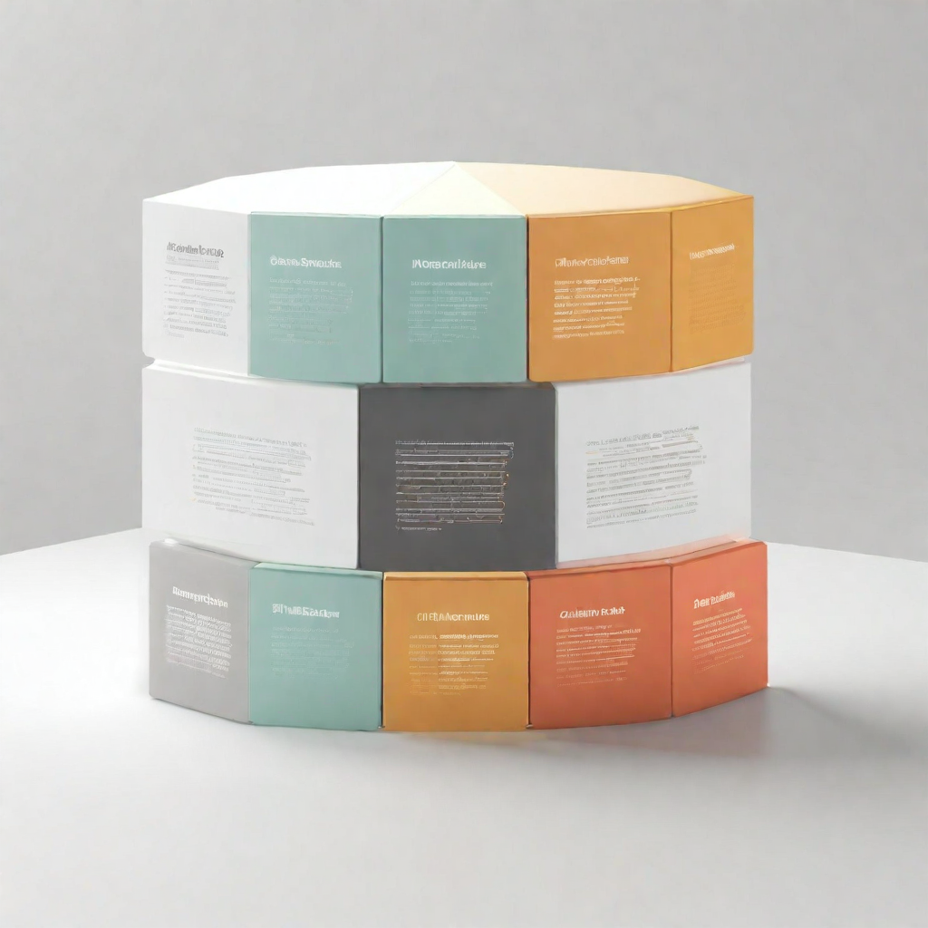
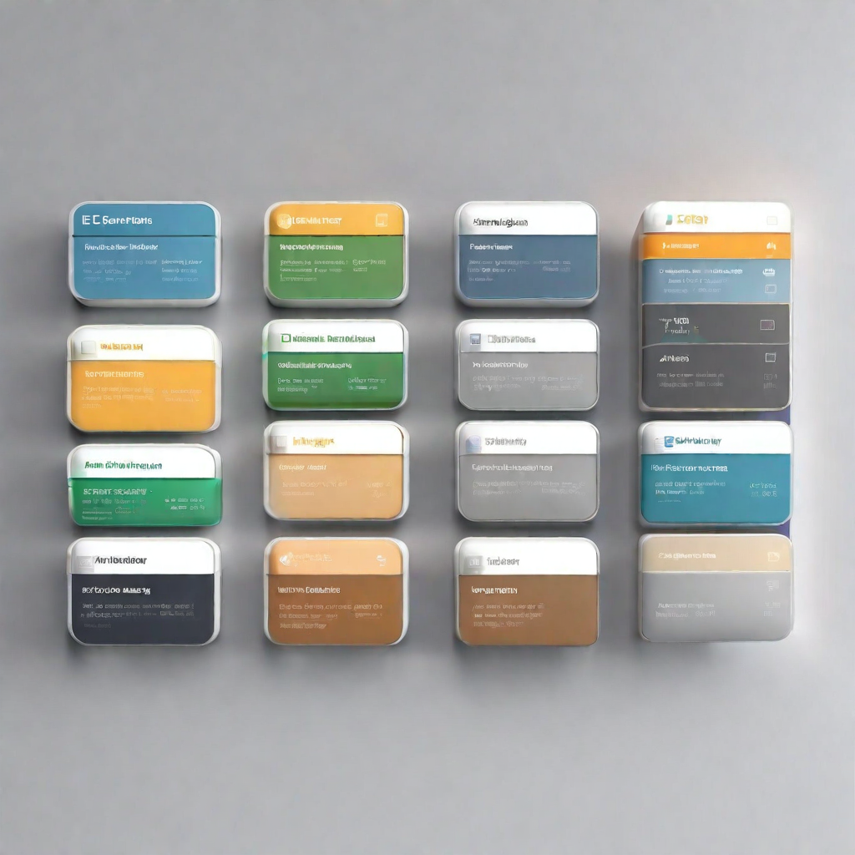
CODE OVERVIEW
Key Components
The code is structured to include key components for fetching and displaying weather information.
API Requests and User Interface
A function or module handles API requests and updates the user interface based on the received data.

Slide 7
CODE OVERVIEW
Key Components
The code is structured to include key components for fetching and displaying weather information.
API Requests and User Interface
A function or module handles API requests and updates the user interface based on the received data.

Slide 8
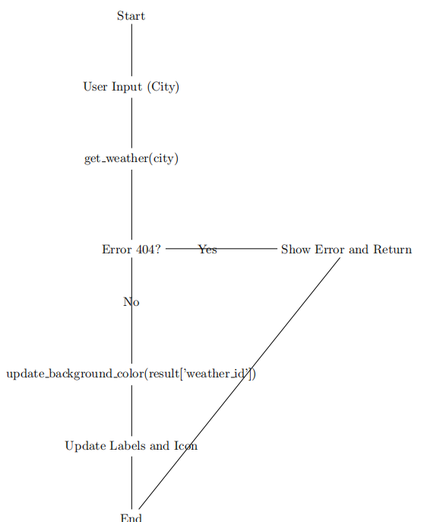
CODE OVERVIEW
Key Components
The code is structured to include key components for fetching and displaying weather information.
API Requests and User Interface
A function or module handles API requests and updates the user interface based on the received data.

Slide 9
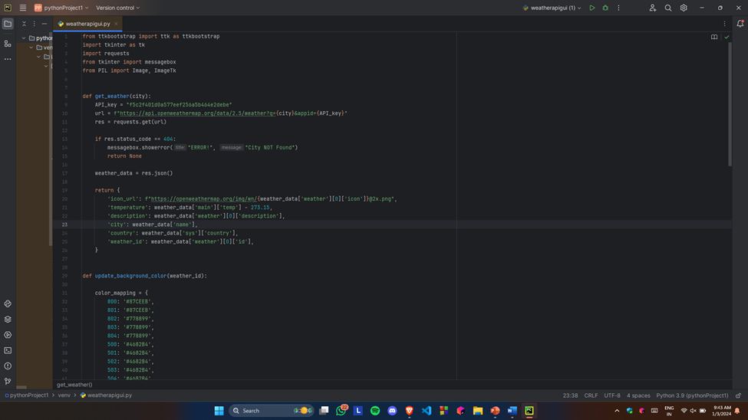
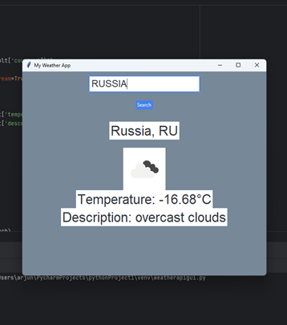

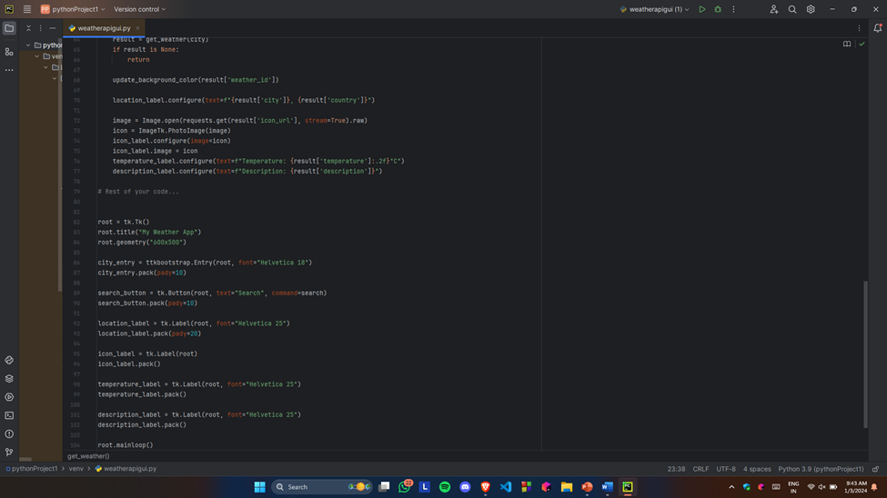
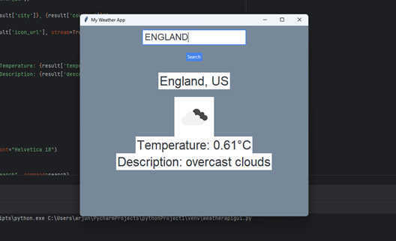
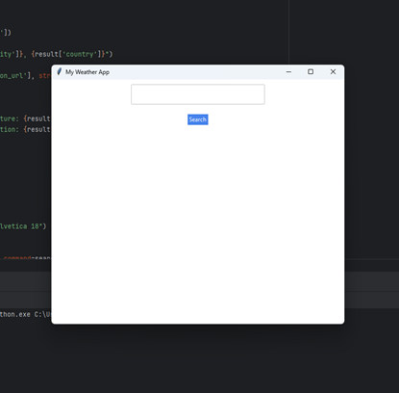
Demo
Showcase the Weather App

Slide 10

THANK
YOU

